Slide 1


The Battle of Neighborhoods
Salih Ekiz
April, 2020
Coursera IBM Data Science Capstone Project

Slide 2
Motivation
Suppose, a person has been living in East York, Toronto for 15 sweet years of his/her life
Now he has to leave East York and relocate to NY for a change in his job location or some other event
Now, he has been used to a particular lifestyle for a longtime. He may likes to go to Mexican restaurants for breakfast, maybe he loves to visit some kind of park in the weekends
Now, he would more like to choose a neighborhood in Manhattan which has all the amenities he was used to in a close proximity.

Slide 3
Objective
Applying k-mean clustering algorithm (by trying two different methods to determine optimal number of clusters) to cluster the neighborhood based on their similarities in different amenities and venues
For defining success we will try to figure out the optimal cluster size by doing some exploratory data analysis on different clusters and trying to observe their similarities

Slide 4
Workflow
Data Pre-processing
Using Google Map API to find ZIP codes and their langitude and longitude values
Using Foursquare API to retrieve venues inside each area defined by langitudes and longitudes
Getting all unique venues
One-hot-encoding transformation for each venue on all locations
Principal Component Analysis to reduce dimensionality by dropping similar features
Finding optimal cluster numbers by applying two different methods: Elbow and Silhouette Score
Fit K-Means using optimized cluster size
Model validation
Model Building

Slide 5
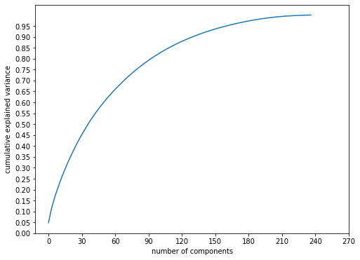
Selecting Principal Components
Having performed PCA, the number of features was reduced to 150 from 250 yet retaining the maximum variance of the dataset

Slide 6
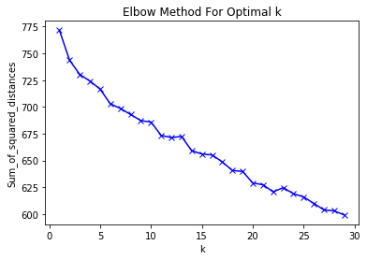
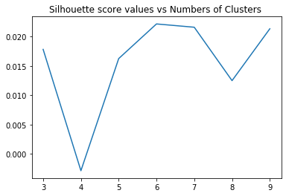
Elbow Method vs Silhouette Score
The number of clusters being 6 experiences a decrease before it and a gradual regular decrease after it in Figure Left
The Silhouette score confirms number of clusters being 6 has its peak in Figure Right

Slide 7
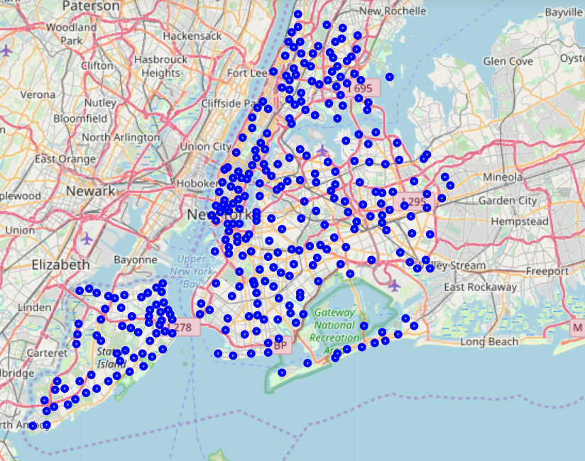
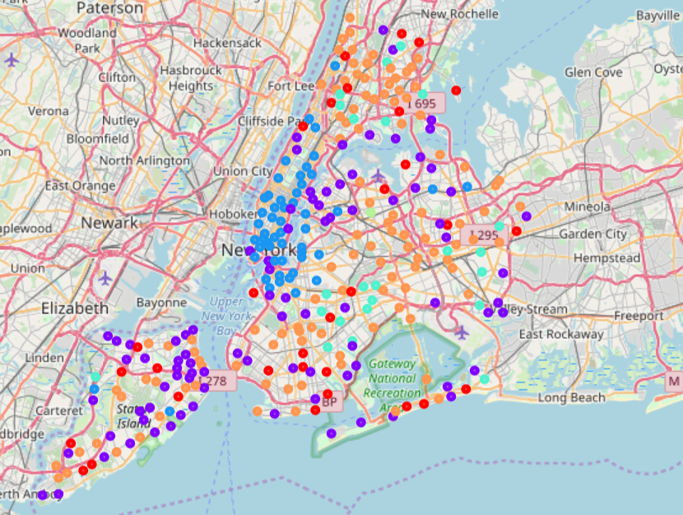
Cluster Visualization
(a) Venues pinned on NY before Clustering (b) Venues pinned on NY after Clustering

Slide 8
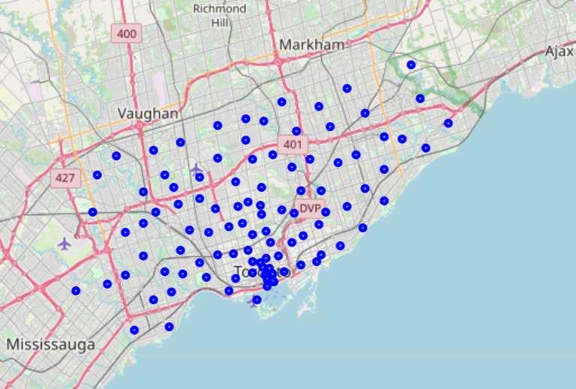
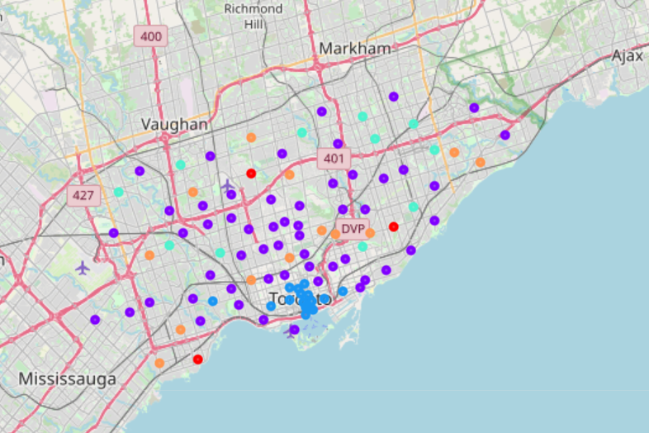
Cluster Visualization
(a) Venues pinned on Toronto before Clustering (b) Venues pinned on Toronto after Clustering

Slide 9
Conclusion
The project work was only done on the zip codes of New York and Toronto, which includes 401 zip codes each having 150 features even after dimensionality reduction with PCA. The problem is that we have a huge feature space but limited number of samples. We can collect data from entire USA and Canada, which will make our dataset well balanced
From map figures, we can spot certain outlier in our data. In future we’ll try to filter out outliers for more robust clustering
There could be other clustering algorithms that can work better. In future, DBSCAN seems to be a good fit for our data
We can sum everything, and convert to a neighborhood recommendation APP

Slide 10
THANK YOU!

